Slide 1

Introducing OOTBee Support Tools
Axel Faust, Bindu Wavell

Slide 2

Back to the Future – BeeCon 2016
Lightning Talk with Oksana Kurysheva
„Top 10 missing features (and ways to add them)“
Support Tools (for Community)
Reset password
Track content usage
JavaScript Console
Property Inheritance
Metadata during upload
Email rendering / previewing
Export / import
User substitution
Flexible Document notification

Slide 3
Support Tools (for Community)
Status Quo – August 2016
JMX not int CE* since 4.0
EE-only: Alfresco Support Tools
JavaScript Console ad-hoc scripts
Lack of (community) activity to add new tools

Slide 4
Support Tools (for Community)
Status Quo – August 2016
JMX not int CE* since 4.0
EE-only: Alfresco Support Tools
JavaScript Console ad-hoc scripts
Lack of (community) activity to add new tools
* Loftux provides framework for custom JMX in CE
https://github.com/loftuxab/alfresco-jmx

Slide 5
Global Virtual Hack-a-thon 2016
3rd event of this type – annually since 2014
No novel / crazy idea (i.e. „turn Alfresco inside-out“)
„Put your money were your mouth is“

Slide 6



Global Virtual Hack-a-thon 2016
3rd event of this type – annually since 2014
No novel / crazy idea (i.e. „turn Alfresco inside-out“)
„Put your money were your mouth is“
Team: Markus Joos, Axel Faust, Sujay Pillai (part-time)

Slide 7
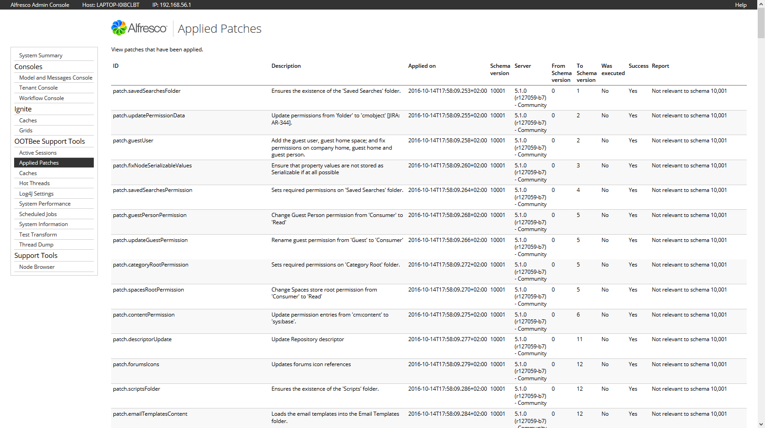
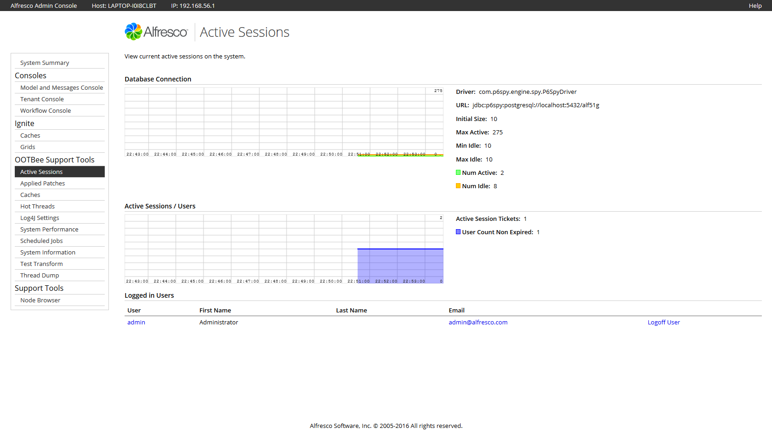
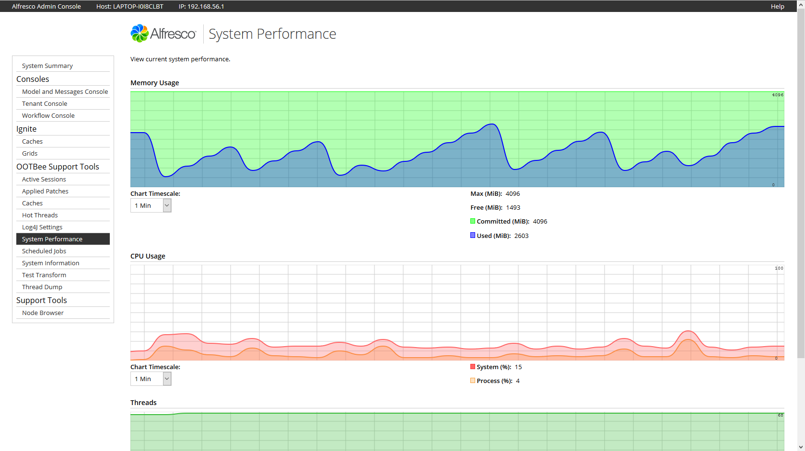
Hack-a-thon results
Published to personal GitHub repo
Ported 8 of 10 tools, excluding
JMX dump
Thread sampler
Showcase on Tech Talk Live
https://www.youtube.com/watch?v=iJMGpOR3-U0

Slide 8
How to proceed?
Recently started own business / freelance
Many existing / pending interests (e.g. Nashorn / JS Console)
Will anyone contribute to private project?
Too many projects have gone, stalled and aged out of relevance

Slide 9

How to proceed?
Recently started own business / freelance
Many existing / pending interests (e.g. Nashorn / JS Console)
Will anyone contribute to private project?
Too many projects have gone, stalled and aged out of relevance
„I am but a Bee – trust in the hive to work with and support me“
(not actually my thoughts at that time – but the best summary of the motivations, don‘t you think?)

Slide 10
Transfer to Order of the Bee
Dec 2016: Call for volunteers
Jan 2017: Kick-off with team of 3 (+1)
Feb 2017: OOTBee Support Tools 0.0.1.0 on Maven Central
May 2017: OOTBee Support Tools 1.0.0.0

Slide 11




Transfer to Order of the Bee
Dec 2016: Call for volunteers
Jan 2017: Kick-off with team of 3 (+1)
Feb 2017: OOTBee Support Tools 0.0.1.0 on Maven Central
May 2017: OOTBee Support Tools 1.0.0.0
Core maintainers Localisation supporters (so far)

Slide 12
New Tools / Features
Repository
System Information (by Jens Goldhammer)
Caches
Log settings reset
Log file download + deletion

Slide 13
New Tools / Features
Repository
System Information (by Jens Goldhammer)
Caches
Log settings reset
Log file download + deletion
Share (Aikau-based)
Log4J Settings (aggregate view)
Dashboard Components
Reset user / site dashboards

Slide 14
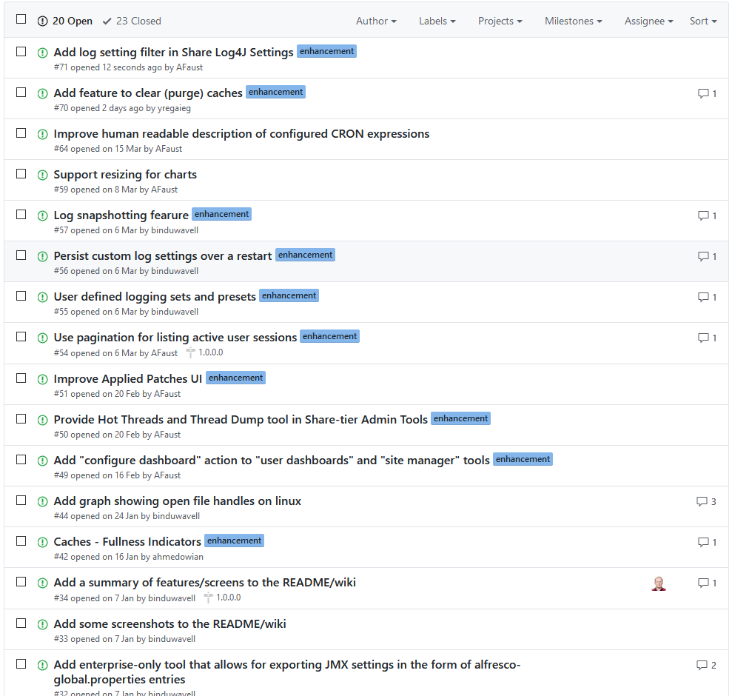
Roadmap
Tool / feature idea highlights
Log snapshotting
Clear historical Activiti data
Expose more existing tools in Share

Slide 15
Roadmap
Tool / feature idea highlights
Log snapshotting
Clear historical Activiti data
Expose more existing tools in Share
Continuous improvements
What about your ideas?
Want to participate / contribute?

Slide 16
Contribution process
Contribution Process Documented
We expect all submissions to conform to the inclusion criteria outlined by the ADDONS comittee of the Order of the Bee.

Slide 17
Contribution process
Contribution Process Documented
We expect all submissions to conform to the inclusion criteria outlined by the ADDONS comittee of the Order of the Bee.
Additionally:
No changes to out-of-the-box capabilities; except for exposing our UI
Only standalone 3rd-party dependencies
Prefer JS/FTL Web Scripts for Repository-tier Admin Console
Aikau for Share-tier Admin Tools
No 3rd-party UI libraries unless absolutely necessary

Slide 18
Conventions
Use a combination of the Forking Workflow and the Feature Branch Workflow
Try to maintain a clean linear version history for our master branch
Documented initial coding style guide

Slide 19
Conventions
Use a combination of the Forking Workflow and the Feature Branch Workflow
Try to maintain a clean linear version history for our master branch
Documented initial coding style guide
Documented Review Criteria
Documented Issue and Pull Request criteria
Documented Code of Conduct

Slide 20
What we are interested in
Real world feedback about what works and what doesn‘t
Ideas for new tools / small enhancements
Feature implementers / contributors
Additional localisations
Bug reports (and fixes!?)
Join our chat room on Gitter

Slide 21
What we are interested in
Real world feedback about what works and what doesn‘t
Ideas for new tools / small enhancements
Feature implementers / contributors
Additional localisations
Bug reports (and fixes!?)
Join our chat room on Gitter

Slide 22
Project
@ReluctantBird83, @binduwavell
Chat
Lesser GNU Public License v3.0
https://github.com/OrderOfTheBee/ootbee-support-tools
https://gitter.im/OrderOfTheBee/support-tools

Slide 23
Slide 4: Sample code
{
// extract avm store id and path
var fullpath = url.extension.split("/");
if (fullpath.length == 0)
{
status.code = 400;
status.message = "Store id has not been provided.";
status.redirect = true;
break script;
}
var storeid = fullpath[0];
var path = (fullpath.length == 1 ? "/" : "/";
}

